Slide 1


תכנון השקיה במים מליחים
תמיר קמאי
המכון למדעי הקרקע, המים והסביבה

Slide 2
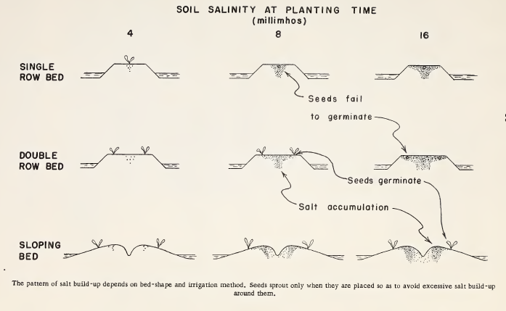
מליחות והשקיה
Bernstein, Milton, and Reeve 1955
מזמן הבינו שהשילוב בין מים למלח הינו קריטי לגידול

Slide 3
מה באג'נדה להיום
למה זה חשוב?
מה הם התהליכים במהלך השקיה במים עם מלח
הגדרות - תגובת הצמח למלח
איך מודדים ומגדירים מליחות מי השקיה
תוצאות מהשטח
כלי תכנון

Slide 4
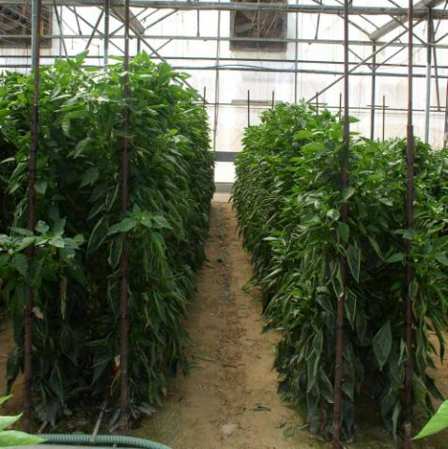
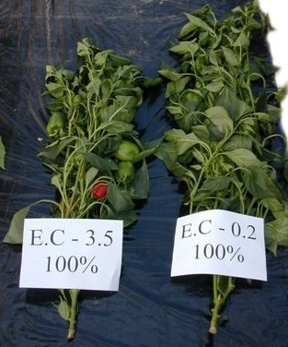
למה זה חשוב?
שורה תחתונה – עליה במליחות גורמת לירידה ביבולים!
השפעה אוסמוטית
יונים רעילים
EC =
0.2 dS/m
EC =
3.5 dS/m

Slide 5
עדויות ארוכות תווך להשפעת המליחות על הגידול והקרקע
30 שנות היסטוריה בארץ:
השקיה בטפטוף
שימוש בקולחים
עדויות של מליחות כבעיה בארץ
אנאליזות קרקע 1995-2012
אנאליזות צמחיות (עלים דיאגנוסטיים של הדרים) 1995-2012
נתרן במוצרי מזון טריים 2012

Slide 6
עדויות ארוכות תווך להשפעת המליחות על הגידול והקרקע
קרקע
Results of samples routinely sent to national labs
EC and SAR in root zone soil samples
I. ~3000 soil samples tested for SAR and EC between 1995 and 2012. 100-200 samples/year.
SAR
EC (dS/m)
Raveh and Ben-Gal 2015 Agric Wat Man

Slide 7
עדויות ארוכות תווך להשפעת המליחות על הגידול והקרקע
עלים של הדרים
Results of samples routinely sent to national labs
Cl and Na in diagnostic citrus leaves
II. ~30,000 citrus leaf samples tested for Na and Cl between 1993 and 2012. 110-985 samples/year
Cl
Na
Raveh and Ben-Gal 2015 Agric Wat Man

Slide 8
עדויות ארוכות תווך להשפעת המליחות על הגידול והקרקע
נתרן - מזון
Sodium in Israeli produce 2012
25 samples each of 26 products collected from farmers and markets
Comparison with standard reference from USDA FDA National Nutrient Database (USDA 2014)
Raveh and Ben-Gal 2015 Agric Wat Man

Slide 9
קידוח שיזף 1, ערבה 1995-2005
4.0
3.5
3.0
2.5
2.0
1.5
1.0
0
2.7 4.0
20 80
(dS/m)
נתונים: רשות הניקוז ערבה
Notes:
9

Slide 10
תהליכים
מלח
מים
דיות
השקיה
גשם והשקיה
חידור
אידוי
חלחול
הצטברות
הסעה
ניקוז לעומק
שטיפה
מי תהום
Notes:
Irrigation is both
1. Delivery (amount, timing) of water for transpiration needs
climatic requirement
2. Maintenance of salt levels (minimal? acceptable?) in soil
leaching requirement

Slide 11
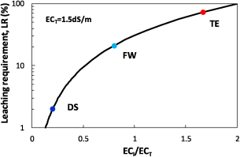
נקז (מתחת בית השורשים) כתלות במליחות (וסוג המים)
Water Resources Research
Volume 51, Issue 5, pages 3419-3436, 8 MAY 2015 DOI: 10.1002/2015WR017071
http://onlinelibrary.wiley.com/doi/10.1002/2015WR017071/full#wrcr21462-fig-0001
Notes:
Leaching requirement, LR, as a function of the ratio between the electrical conductivity of the irrigation water, EC_{I}, and a prescribed threshold electrical conductivity characterizing the crop, EC_{T}=1.5 dS/m for conventional irrigation following Rhoades and Loveday [] [Marcar et al., ]. The colored dots illustrate the LR for the representative salinity of the different water qualities (TE, FW, and DS).
IF THIS IMAGE HAS BEEN PROVIDED BY OR IS OWNED BY A THIRD PARTY, AS INDICATED IN THE CAPTION LINE, THEN FURTHER PERMISSION MAY BE NEEDED BEFORE ANY FURTHER USE. PLEASE CONTACT WILEY'S PERMISSIONS DEPARTMENT ON PERMISSIONS@WILEY.COM OR USE THE RIGHTSLINK SERVICE BY CLICKING ON THE 'REQUEST PERMISSIONS' LINK ACCOMPANYING THIS ARTICLE. WILEY OR AUTHOR OWNED IMAGES MAY BE USED FOR NON-COMMERCIAL PURPOSES, SUBJECT TO PROPER CITATION OF THE ARTICLE, AUTHOR, AND PUBLISHER.

Slide 12
Crop salt tolerance
Plant response to salts
  The threshold salinity level
  the yield decrease per unit of salinity increase beyond the threshold
Salt tolerance evaluation
  Salt tolerance (in general)
  Toxicity (specific)

Slide 13
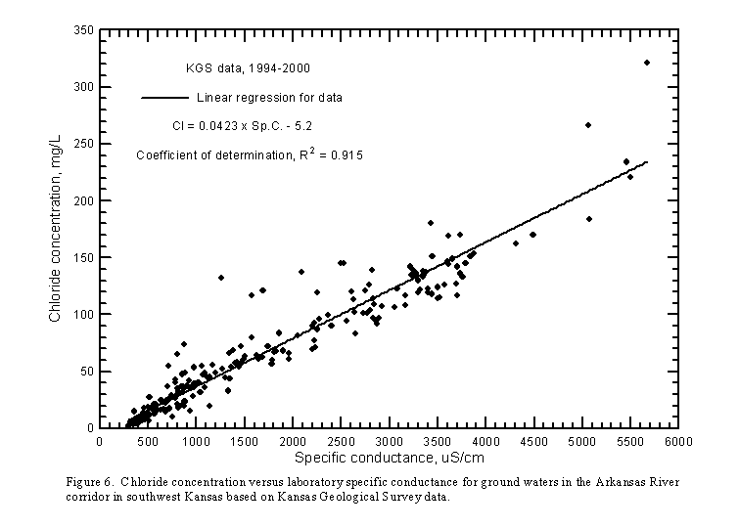
Electrical Conductivity (EC)
Measuring the concentration of salt in soil water is difficult.
The electrical conductivity of the soil water (extract), EC_{e}, is directly proportional to the ionic concentration

Slide 14
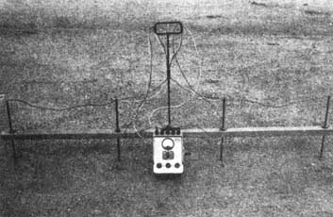
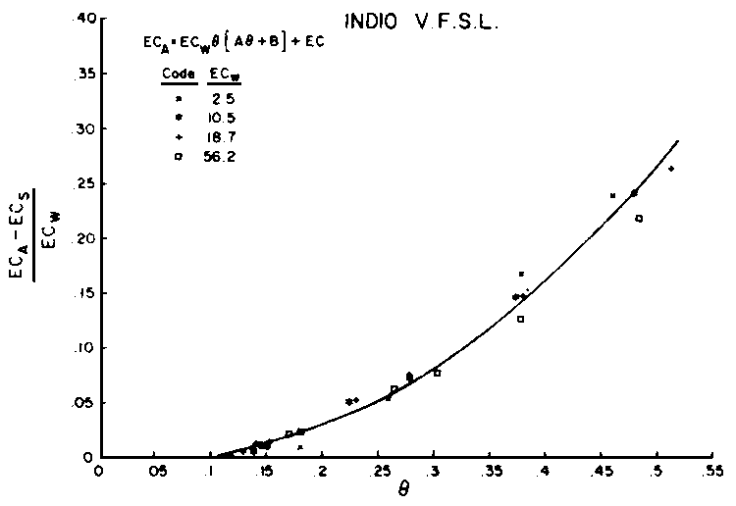
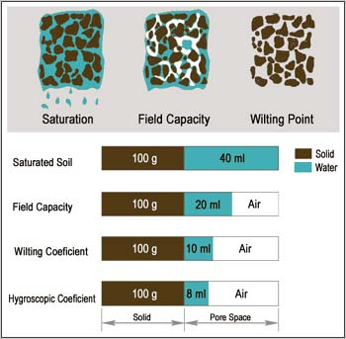
Soil EC

Slide 15
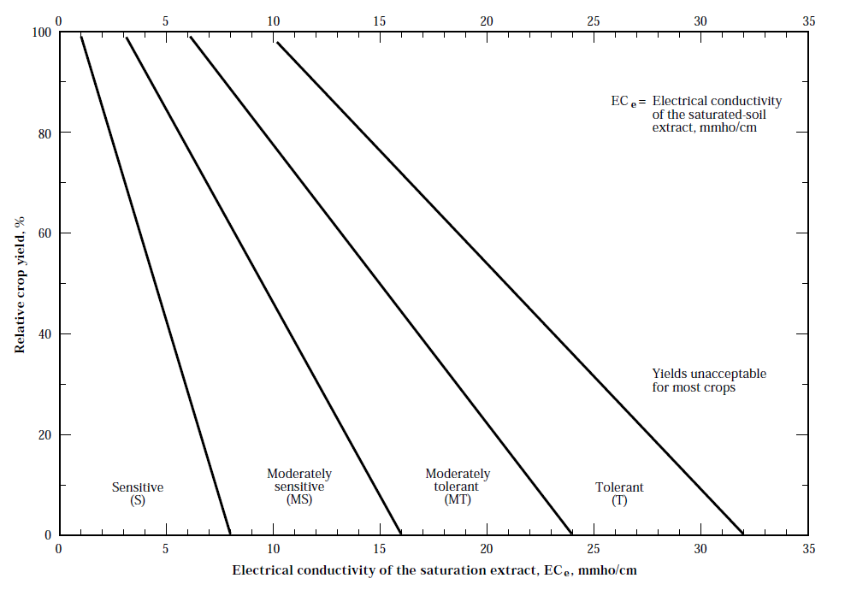
Divisions for classifying crop tolerance to salinity (adapted from Maas 1986)

Slide 16
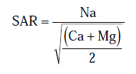
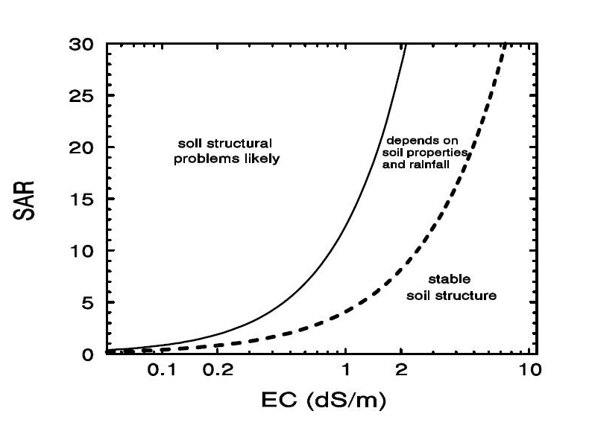
SAR - another Measure for Salinity

Slide 17
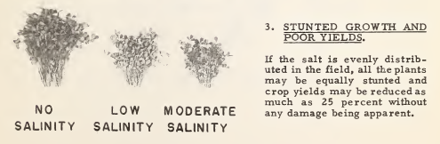
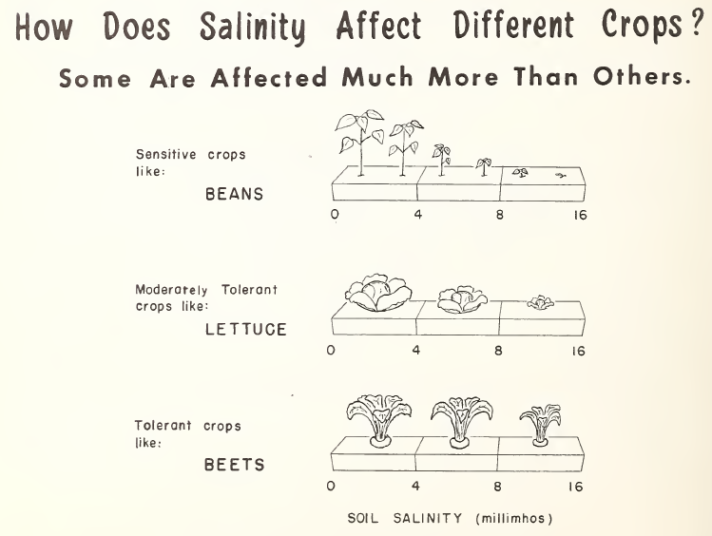
מה בשטח?

Slide 18
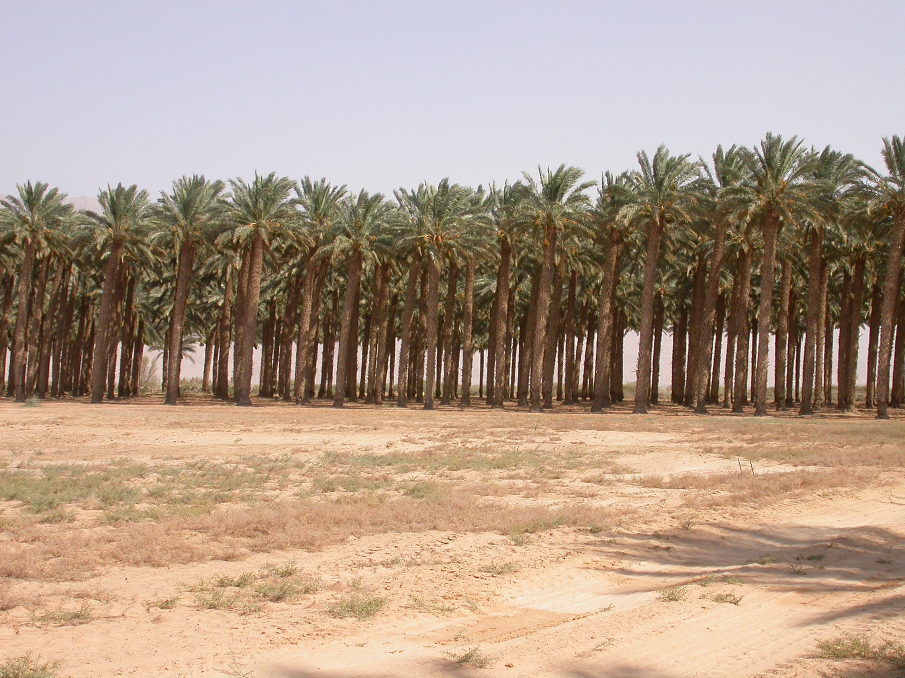
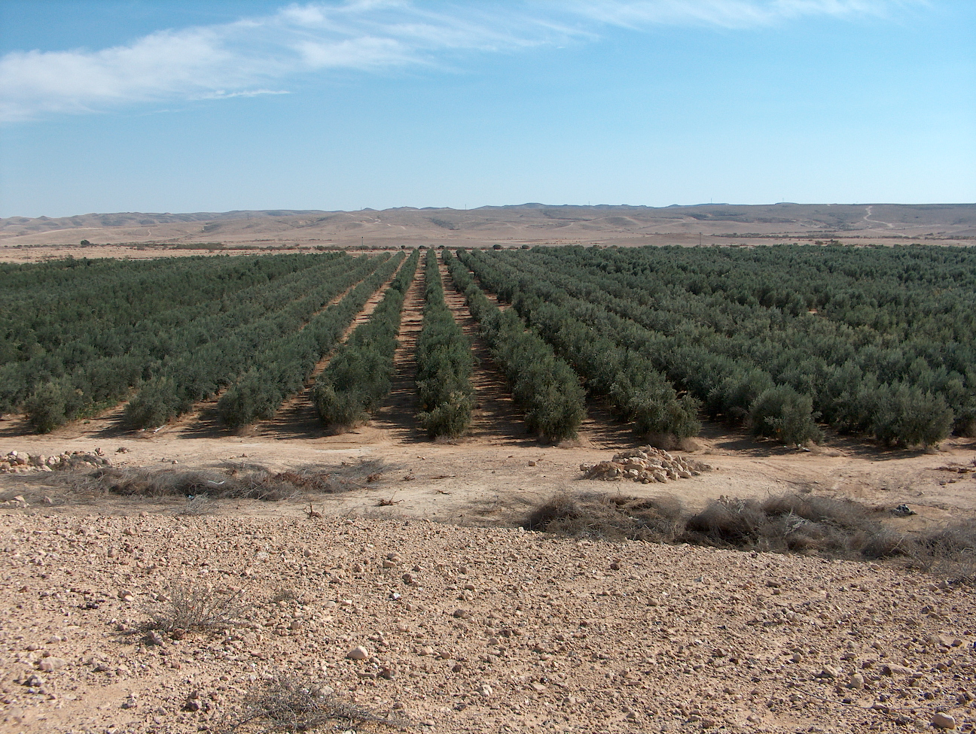
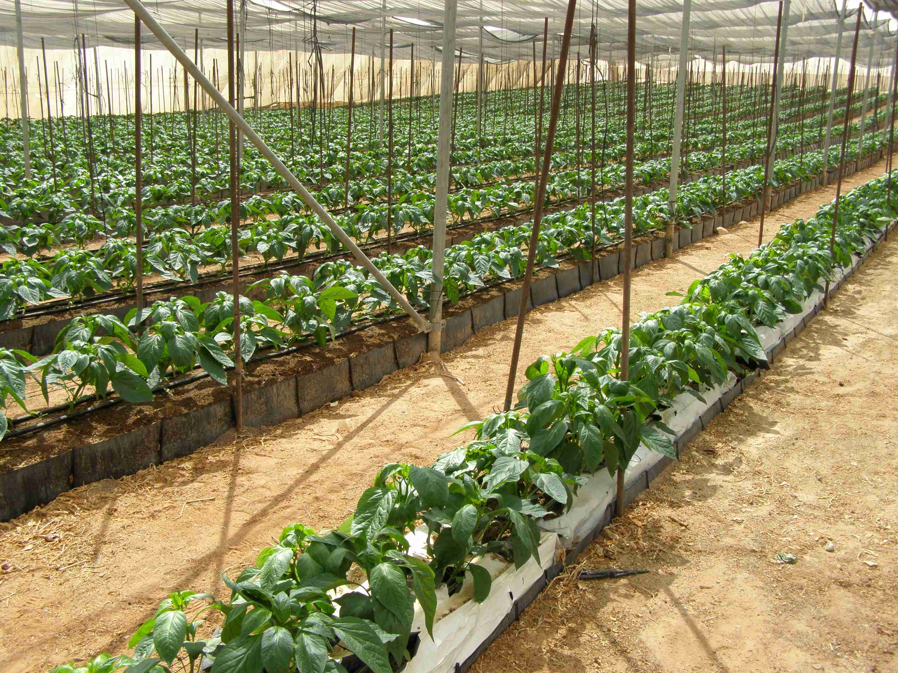
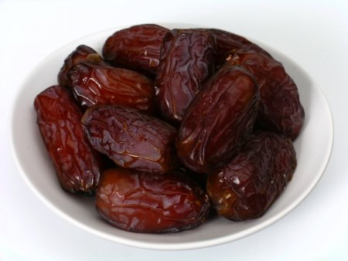
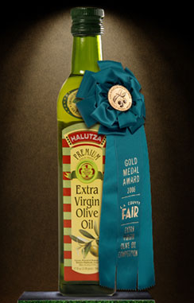
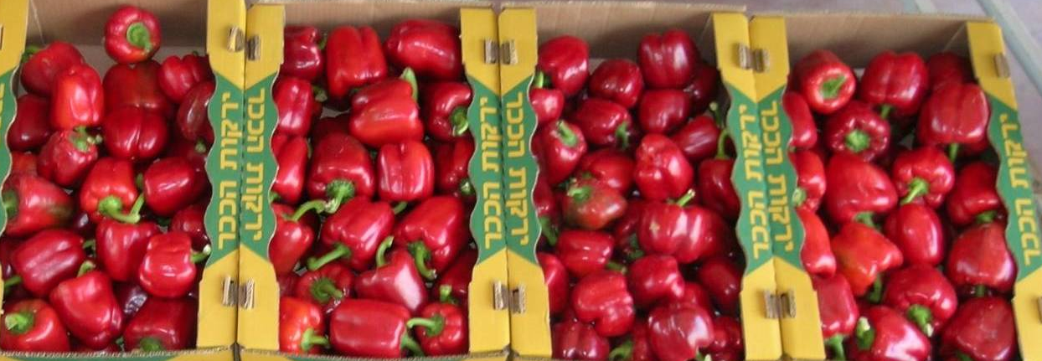
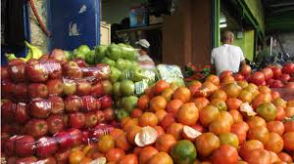
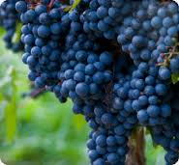
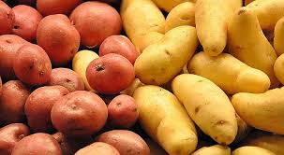
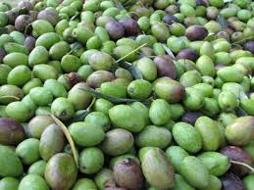
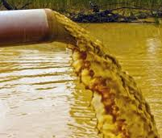
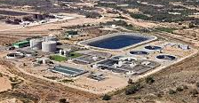
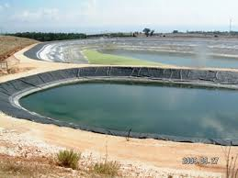
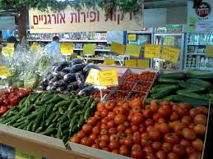
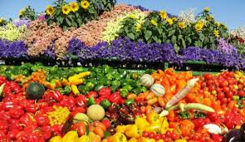
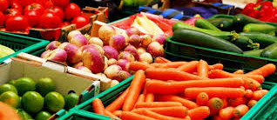
Irrigation water quality in Israel
Brackish water
2.5 – 6 dS/m
4 – 5 dS/m
2 – 3.5 dS/m
1 – 13 tons of salt/hectare/year added with irrigation water
Recycled waste water
1 - 2.5 dS/m

Slide 19
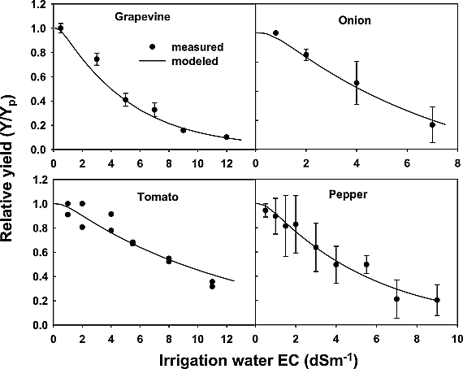
יבול כתלות במליחות
Water Resources Research
Volume 43, Issue 8, W08418, 18 AUG 2007 DOI: 10.1029/2006WR005313
http://onlinelibrary.wiley.com/doi/10.1029/2006WR005313/full#wrcr10996-fig-0002
Notes:
Relative yield (relative total above ground dry biomass) of grape, onion, pepper, and tomato as a function of irrigation water salinity, when water is not limiting. Peppers were grown in a net house; others were in outdoor lysimeters at the Arava Research Station, Yotvata, Israel, where the soil is Arava sandy loam. Symbols are average experimental results, vertical lines are standard deviations, and the lines are relative yield computed by equations (12) and (13). Model parameters for the calculations are given in Tables 1 and 2.
IF THIS IMAGE HAS BEEN PROVIDED BY OR IS OWNED BY A THIRD PARTY, AS INDICATED IN THE CAPTION LINE, THEN FURTHER PERMISSION MAY BE NEEDED BEFORE ANY FURTHER USE. PLEASE CONTACT WILEY'S PERMISSIONS DEPARTMENT ON PERMISSIONS@WILEY.COM OR USE THE RIGHTSLINK SERVICE BY CLICKING ON THE 'REQUEST PERMISSIONS' LINK ACCOMPANYING THIS ARTICLE. WILEY OR AUTHOR OWNED IMAGES MAY BE USED FOR NON-COMMERCIAL PURPOSES, SUBJECT TO PROPER CITATION OF THE ARTICLE, AUTHOR, AND PUBLISHER.

Slide 20
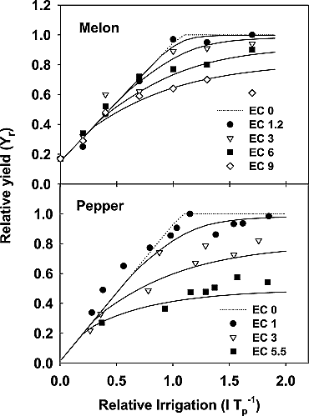
יבול מלון ופלפל בכמויות שונות של מים ומליחות
Water Resources Research
Volume 43, Issue 8, W08418, 18 AUG 2007 DOI: 10.1029/2006WR005313
http://onlinelibrary.wiley.com/doi/10.1029/2006WR005313/full#wrcr10996-fig-0004
Notes:
Relative yield of melon and pepper as a function of irrigation level and irrigation water salinity. Field and lysimeter experiments were conducted at the Arava Research Station, Yotvata. Symbols are experimental results; lines are relative yield computed by equations (12) and (13). Model parameters for the calculations are given in Tables 1 and 2.
IF THIS IMAGE HAS BEEN PROVIDED BY OR IS OWNED BY A THIRD PARTY, AS INDICATED IN THE CAPTION LINE, THEN FURTHER PERMISSION MAY BE NEEDED BEFORE ANY FURTHER USE. PLEASE CONTACT WILEY'S PERMISSIONS DEPARTMENT ON PERMISSIONS@WILEY.COM OR USE THE RIGHTSLINK SERVICE BY CLICKING ON THE 'REQUEST PERMISSIONS' LINK ACCOMPANYING THIS ARTICLE. WILEY OR AUTHOR OWNED IMAGES MAY BE USED FOR NON-COMMERCIAL PURPOSES, SUBJECT TO PROPER CITATION OF THE ARTICLE, AUTHOR, AND PUBLISHER.

Slide 21
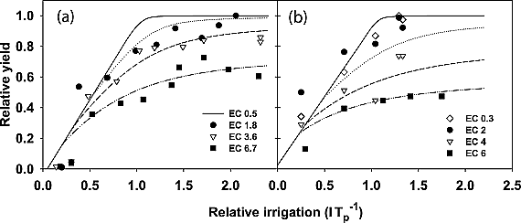
יבול תירס בקרקעות שונות (שמאלי יותר חול)
Water Resources Research
Volume 43, Issue 8, W08418, 18 AUG 2007 DOI: 10.1029/2006WR005313
http://onlinelibrary.wiley.com/doi/10.1029/2006WR005313/full#wrcr10996-fig-0005
Notes:
Relative yield of corn as a function of irrigation level and irrigation water salinity. Symbols are experimental results from (a) Russo and Bakker [1987] with Arava sandy loam and (b) Hanks et al. [1978] with Millville loam. The lines are relative yield computed by equations (12) and (13). Model parameters for the calculations are given in Tables 1 and 2.
IF THIS IMAGE HAS BEEN PROVIDED BY OR IS OWNED BY A THIRD PARTY, AS INDICATED IN THE CAPTION LINE, THEN FURTHER PERMISSION MAY BE NEEDED BEFORE ANY FURTHER USE. PLEASE CONTACT WILEY'S PERMISSIONS DEPARTMENT ON PERMISSIONS@WILEY.COM OR USE THE RIGHTSLINK SERVICE BY CLICKING ON THE 'REQUEST PERMISSIONS' LINK ACCOMPANYING THIS ARTICLE. WILEY OR AUTHOR OWNED IMAGES MAY BE USED FOR NON-COMMERCIAL PURPOSES, SUBJECT TO PROPER CITATION OF THE ARTICLE, AUTHOR, AND PUBLISHER.

Slide 22
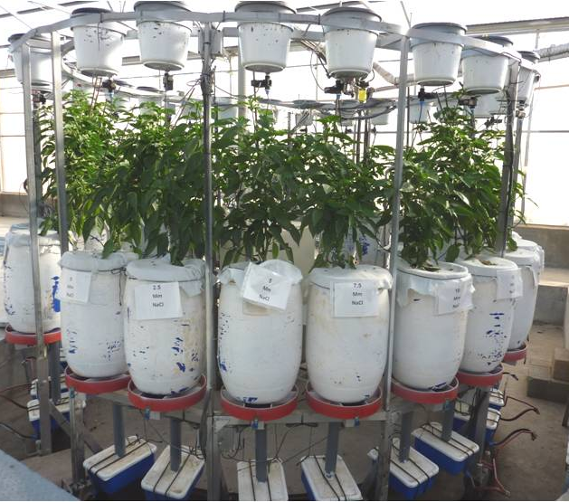

מים מותפלים ומליחים
אפשריות ניהוליות
Ece threshold = 1.03 dS/m, slope = 12%
יבול יחסי
Y/Yp
ECe (dS/m)
מליחות
ECe50 = 5.98
p = 1.65
Groenveld et al 2013 Vadose Zone Journal

Slide 23
ANSWER model
Analytical Salt-Water (ANSWER) model
[Shani et al., 2007, 2009]
https://answerapp.github.io/answer-app/

Slide 24
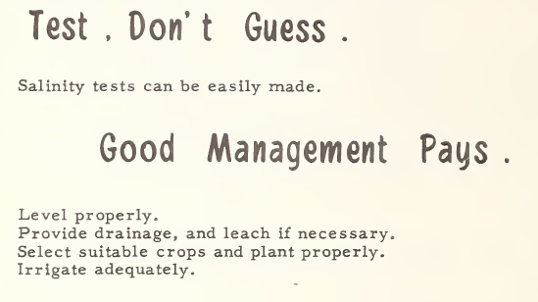
תודה
אלון בן-גל
שמואל אסולין
אפי טריפלר

Slide 25
שאלות

